Slide 1
Null models
Anthony Fodor
UNC Charlotte
Bioinformatics and Genomics

Slide 2
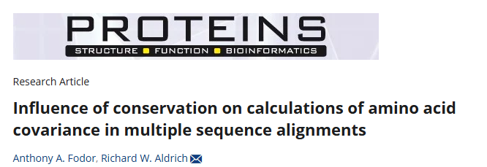
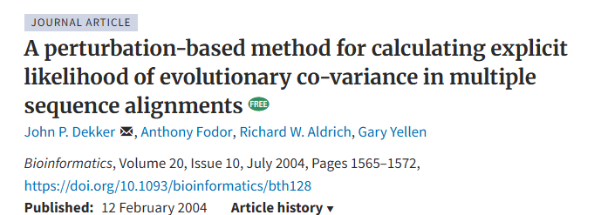
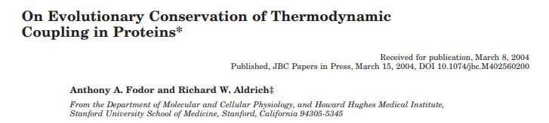
These 3 papers got me my only interview (and only job offer)….

Slide 3
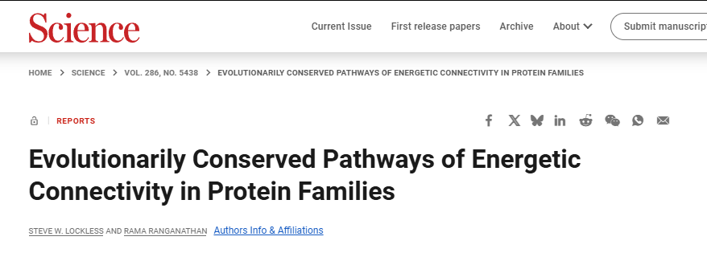
My first bioinformatics papers were a response to this paper…
This paper has been cited > 1,600 times
This was an algorithm to find correlated mutations in protein alignments.
The idea was that you could use these correlated mutations to map allosteric pathways
(like conformational changes in ion channels).
This turned out to be a terrible idea for a lot of reasons…
But what surprised me then (and now) was how easily you could find a null model to break a published algorithm

Slide 4
Correlated mutations in an alignment
T...Y
T...Y
T...Y
T...Y
T...Y
T...Y

Slide 5
Correlated mutations in an alignment
T...Y
T...Y
T...Y
T...Y
T...Y
T...Y
L...S
L...S
L...S
L...S
L...S
L...S

Slide 6
Correlated mutations in an alignment
T...Y
T...Y
T...Y
T...Y
T...Y
T...Y
L...S
L...S
L...S
L...S
L...S
L...S
T...S

Slide 7
Correlated mutations in an alignment
T...Y
T...Y
T...Y
T...Y
T...Y
T...Y
L...S
L...S
L...S
L...S
L...S
L...S
T...S
L...Y

Slide 8
We evaluated four metrics of correlated mutations:
T...Y
Observed minus expected squared (OMES):
T...Y
Chi-square like difference between
the observed and expected number of
pairs of residues (Kass and Horovitz, 2002)
T...Y
T...Y
T...Y
T...Y
Mutual Information (MI):
based on the ratio of the observed and
expected number of pairs of residues
(Atchley et al, 1999)
L...S
L...S
L...S
L...S
L...S
Statistical Coupling Analysis (SCA):
based on the conditional probability of
sub-alignments (Lockless and Ranganathan, 1999 )
L...S
T...S
L...Y
McLachlan Based Substitution Correlation(McBASC):
For each column, get from the matrix
the substitution value for all pairs of rows. Calculate
Pearson’s r for all these values. (Gobel et al, 1994)

Slide 9
An alignment made up of the 20 amino acids
AC
DE
FG
HI
KL
MN
PQ
RS
TU
WV

Slide 10
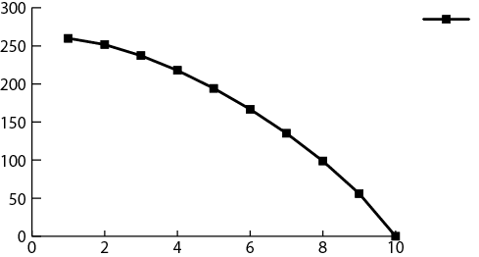
An alignment made up of the 20 amino acids
AA
DE
FG
HI
KL
MN
PQ
RS
TU
WV
SCA
score
Increasingly Random
Increasingly Conserved

Slide 11
An alignment made up of the 20 amino acids
AA
AA
FG
HI
KL
MN
PQ
RS
TU
WV
SCA
score
Increasingly Random
Increasingly Conserved

Slide 12
An alignment made up of the 20 amino acids
AA
AA
AA
HI
KL
MN
PQ
RS
TU
WV
SCA
score
Increasingly Random
Increasingly Conserved

Slide 13
An alignment made up of the 20 amino acids
AA
AA
AA
AA
KL
MN
PQ
RS
TU
WV
SCA
score
Increasingly Random
Increasingly Conserved

Slide 14
An alignment made up of the 20 amino acids
AA
AA
AA
AA
AA
MN
PQ
RS
TU
WV
SCA
score
Increasingly Random
Increasingly Conserved

Slide 15
An alignment made up of the 20 amino acids
AA
AA
AA
AA
AA
AA
PQ
RS
TU
WV
SCA
score
Increasingly Random
Increasingly Conserved

Slide 16
An alignment made up of the 20 amino acids
AA
AA
AA
AA
AA
AA
AA
RS
TU
WV
SCA
score
Increasingly Random
Increasingly Conserved

Slide 17
An alignment made up of the 20 amino acids
AA
AA
AA
AA
AA
AA
AA
AA
TU
WV
SCA
score
Increasingly Random
Increasingly Conserved

Slide 18
An alignment made up of the 20 amino acids
AA
AA
AA
AA
AA
AA
AA
AA
AA
WV
SCA
score
Increasingly Random
Increasingly Conserved

Slide 19
An alignment made up of the 20 amino acids
AA
AA
AA
AA
AA
AA
AA
AA
AA
AA
SCA
score
Increasingly Random
Increasingly Conserved

Slide 20
An alignment made up of the 20 amino acids
AA
AA
AA
AA
AA
AA
AA
AA
AA
AA
SCA
score
Increasingly Random
Increasingly Conserved
Probably not the best algorithm.
Just the inverse of column conservation!

Slide 21
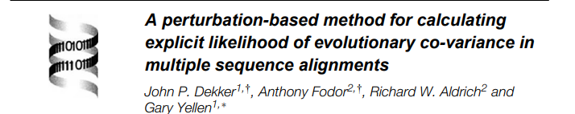
An alignment made up of the 20 amino acids
AA
AA
AA
AA
AA
AA
AA
AA
AA
AA
SCA
score
Increasingly Random
Increasingly Conserved
Probably not the best algorithm.
Just the inverse of column conservation!
On real sequences, correlation coefficient
of SCA with sequence entropy is > 0.9

Slide 22
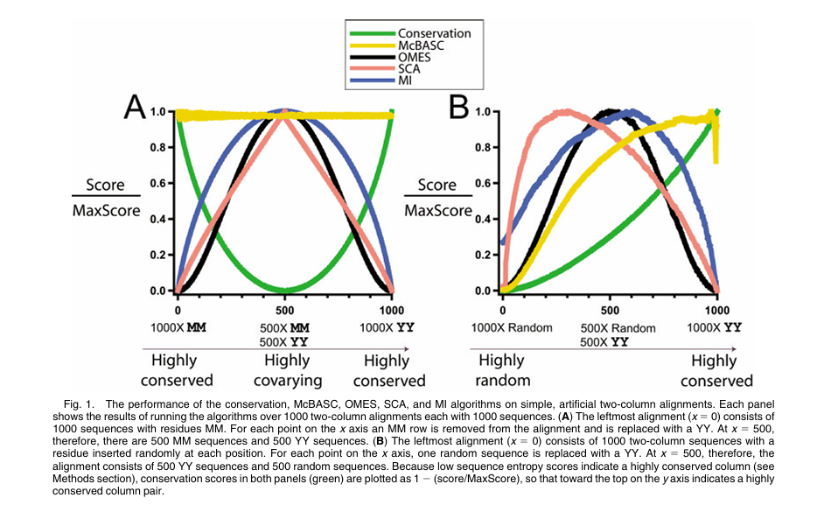

Slide 23
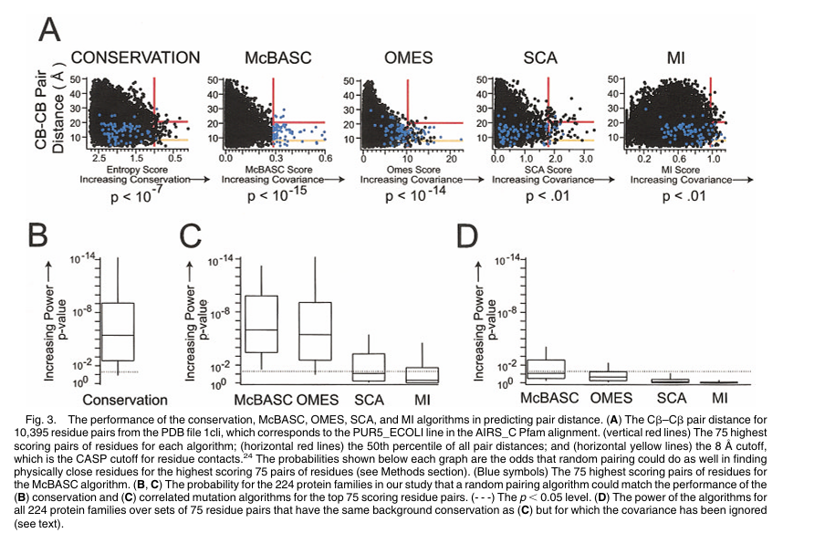

Slide 24
Analyses that have relied on the SCA algorithm:
Suel et al, Evolutionarily conserved networks of residues mediate allosteric communication in proteins, Nat Struct Biol. 2003 Jan;10(1):59-69.
Hatley et al. Allosteric determinants in guanine nucleotide-binding
proteins. PNAS 2003,100:14445-14450.
Shulman et al. Structural determinants of allosteric ligand activation
in RXR heterodimers. Cell 2004,116:417-429.
Magliery and Regan L. Beyond consensus: statistical free energies reveal hidden interactions in the design of a TPR motif. J Mol Biol. 2004 ;343(3):731-45.
Estabrook et al, Statistical coevolution analysis and molecular dynamics: Identification of amino acid pairs essential for catalysis. PNAS 2005,102 : 994-999

Slide 25
So are we doing any better in bioinformatics now?

Slide 26
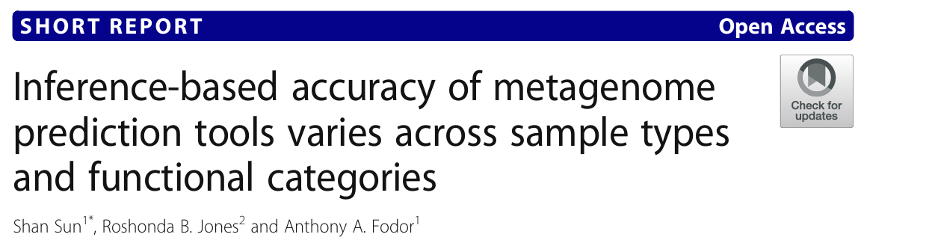


Slide 27
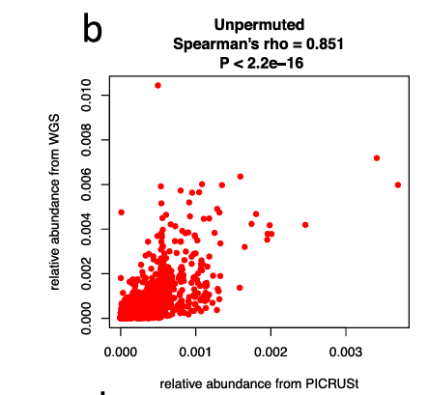
For example, how well is PiCRUSt doing at predicting gene function for datasets where we have both 16S and WGS?

Slide 28
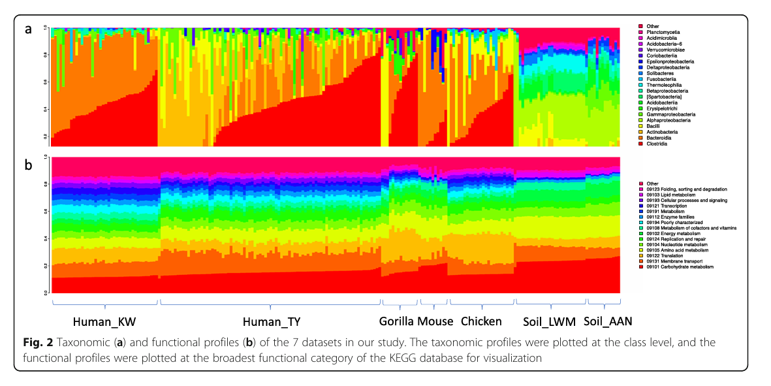
Gene profiles are more consistent than taxonomy…

Slide 29
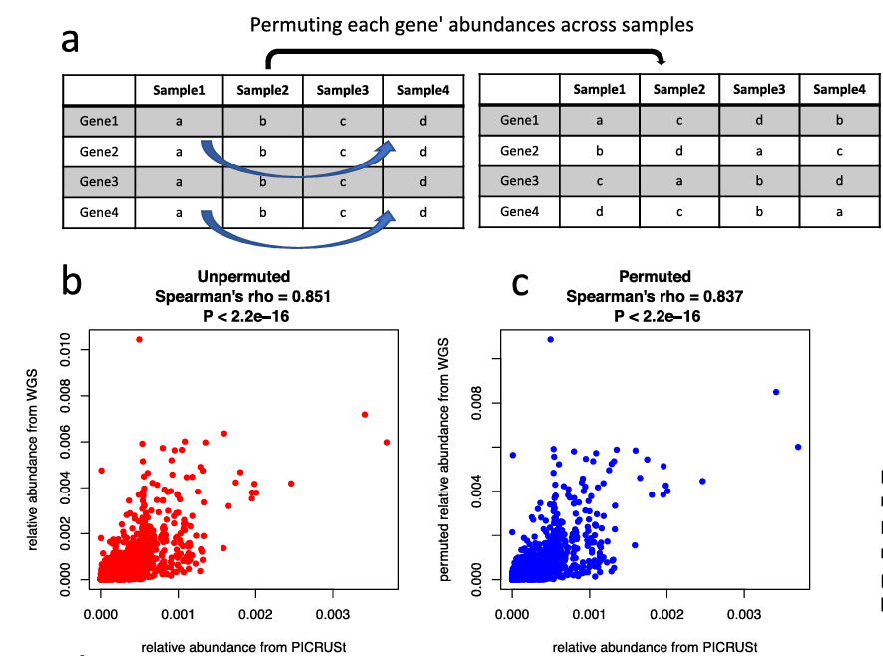

Slide 30
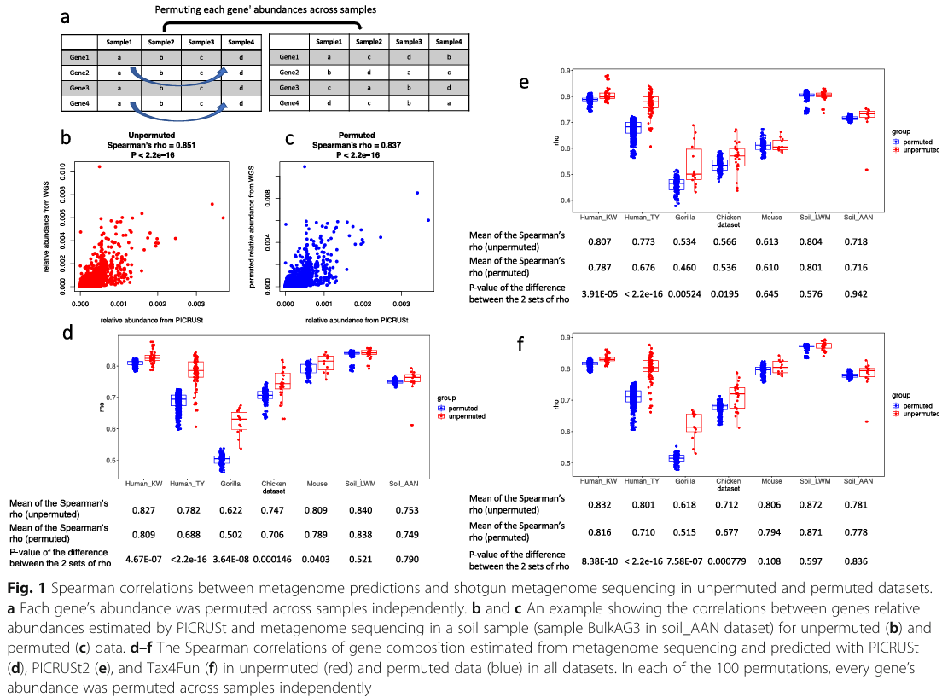
Permuted samples are often nearly as good at predicting WGS as unpermuted

Slide 31
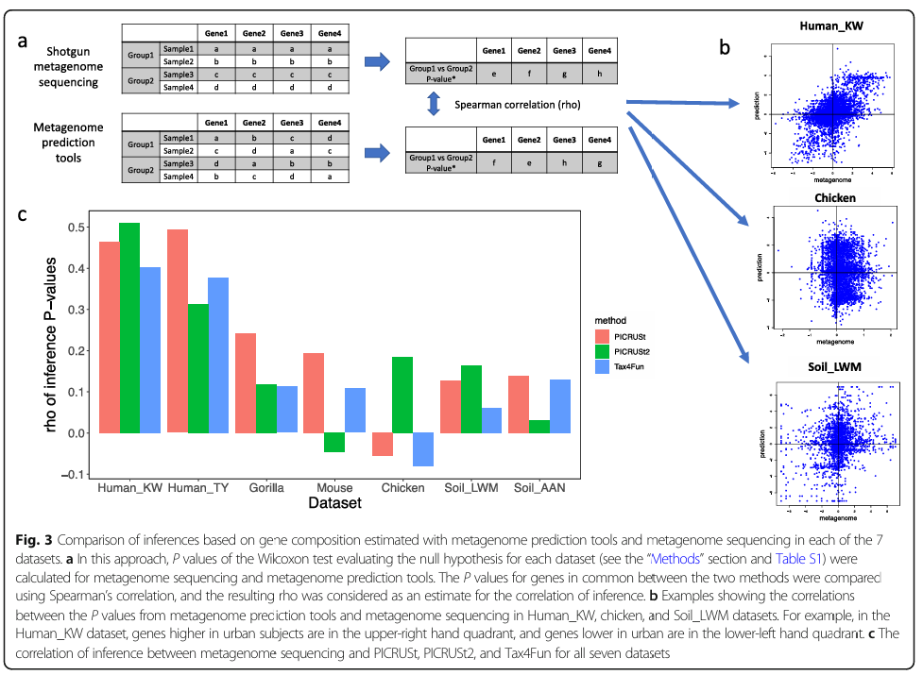
Performance in inference space varies from mediocre to random…

Slide 32
Distinguishing artifact from signal remains a crucial problem in current informatics…

Slide 33
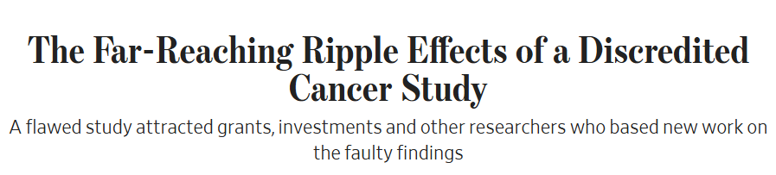

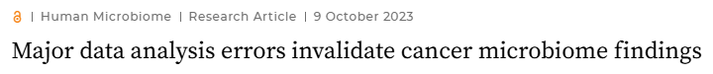

(Wall Street journal)
The article describes an initial Knight lab analysis done in this paper which argues
that there is a microbial signature in cancer.
The retracted paper is here: https://www.nature.com/articles/s41586-020-2095-1
The paper was retracted mostly because of an analysis done here https://journals.asm.org/doi/10.1128/mbio.01607-23
But the original authors responded that their first analysis was largely correct here: https://www.nature.com/articles/s41388-024-02974-w

Slide 34
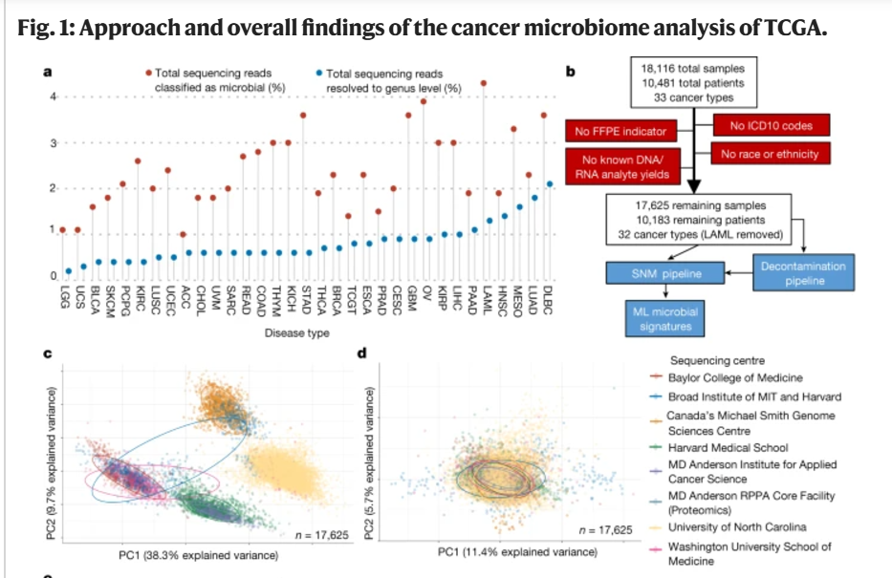

Slide 35
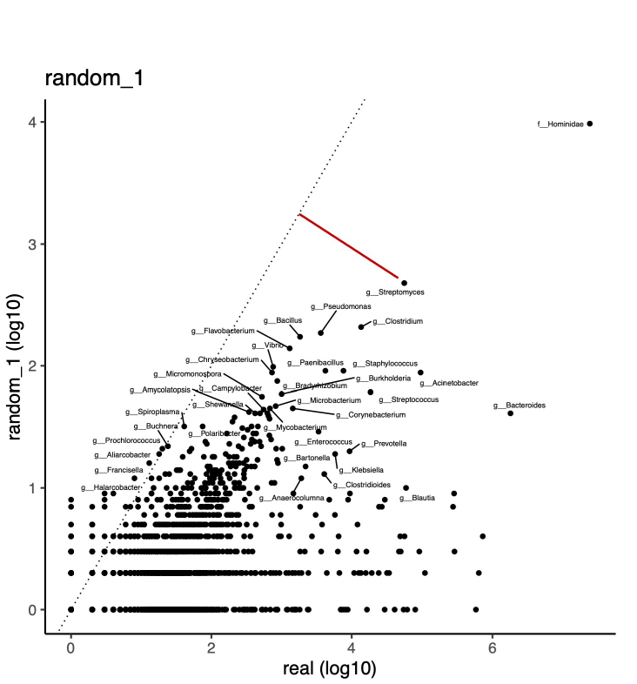
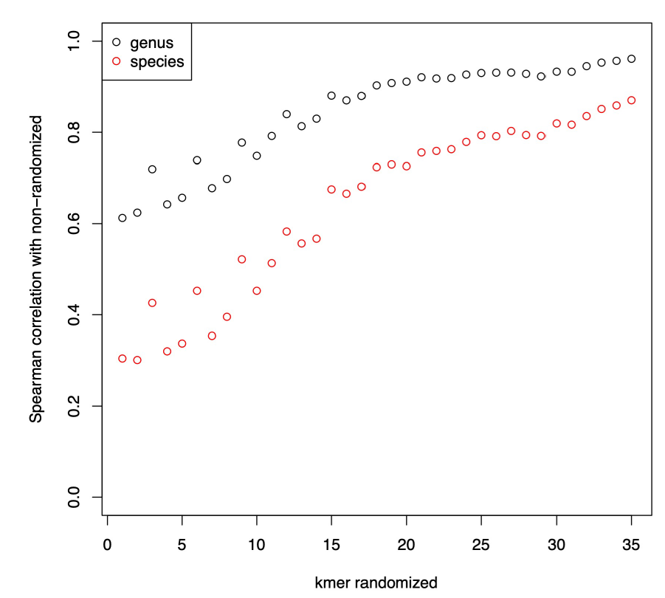
Shuffling input sequences yields classifications with significant correlations to unshuffled sequences
Shan Sun
Remarkably, there is a strong codon signal in the shuffled and un-shuffled sequences

Slide 36
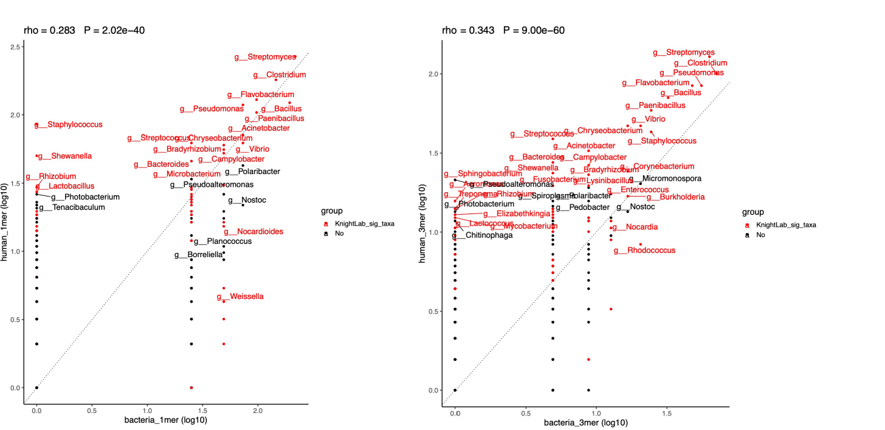
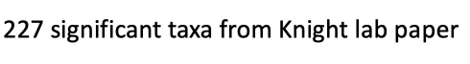

Slide 37
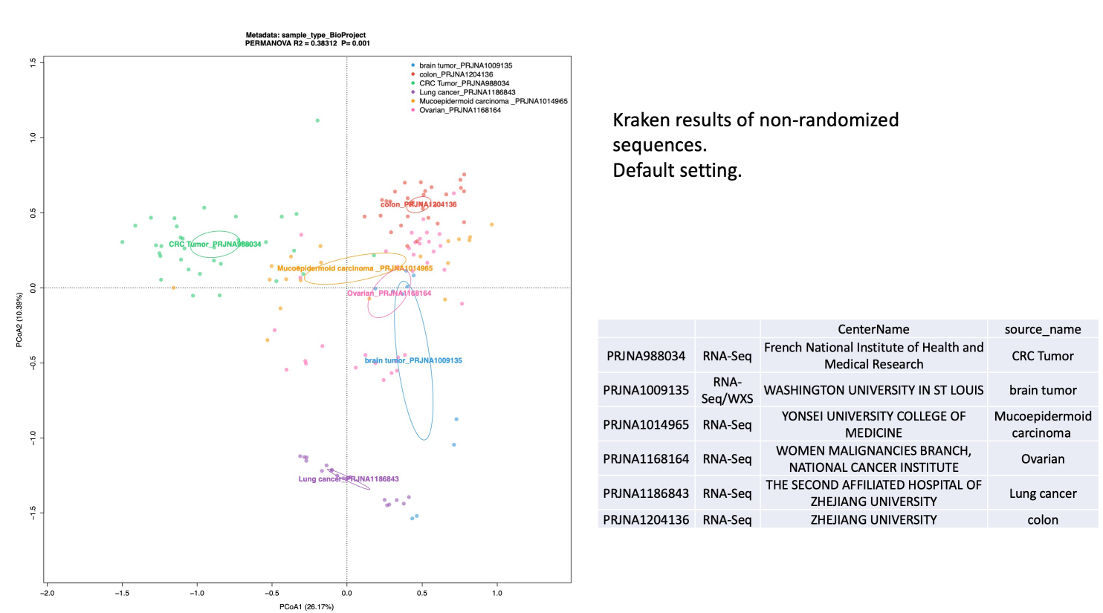

Slide 38
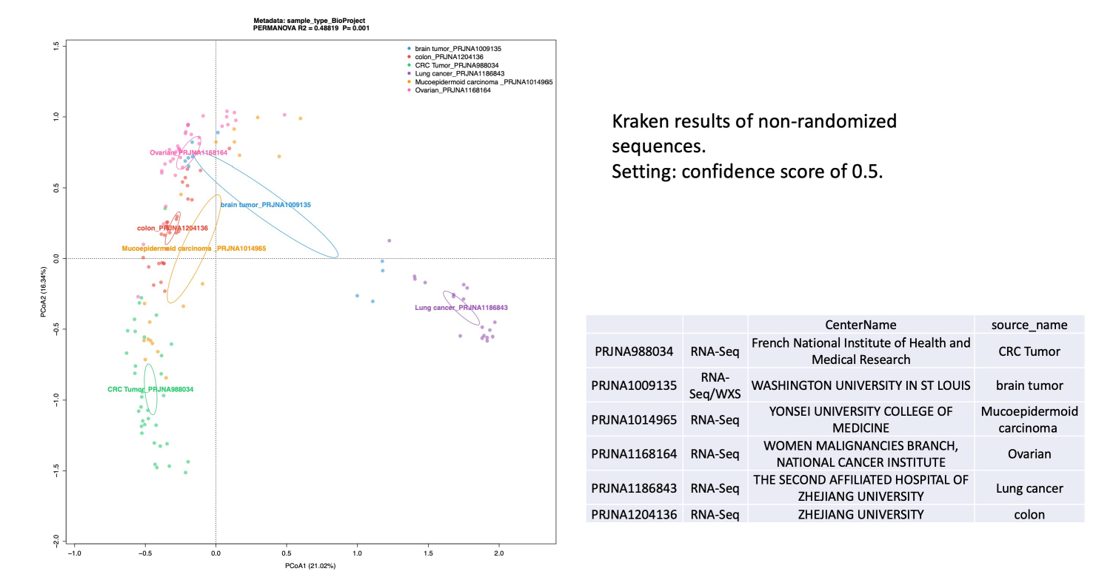

Slide 39
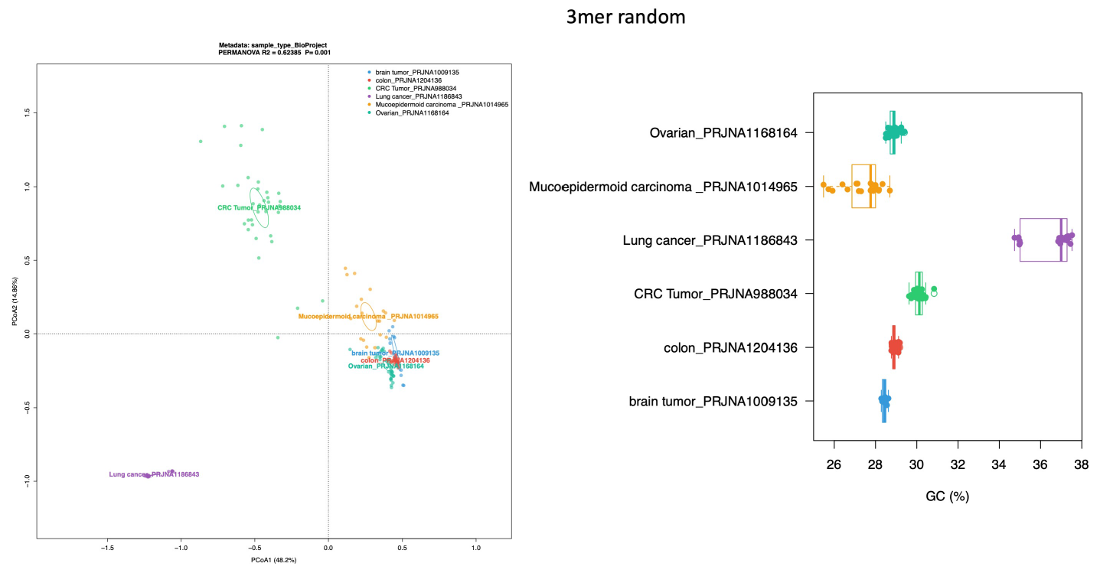

Slide 40
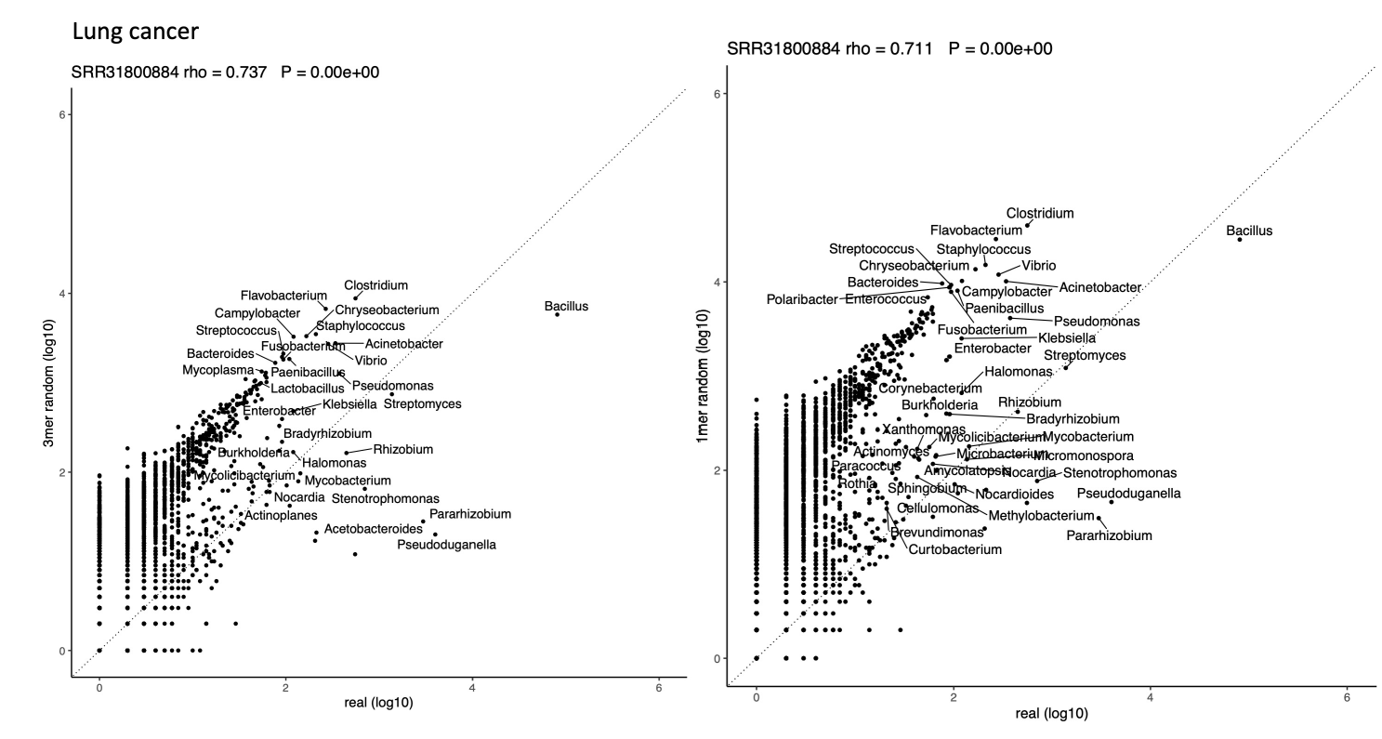
Random null sequences can explain some (but certainly not all) of Kraken’s observations

Slide 41
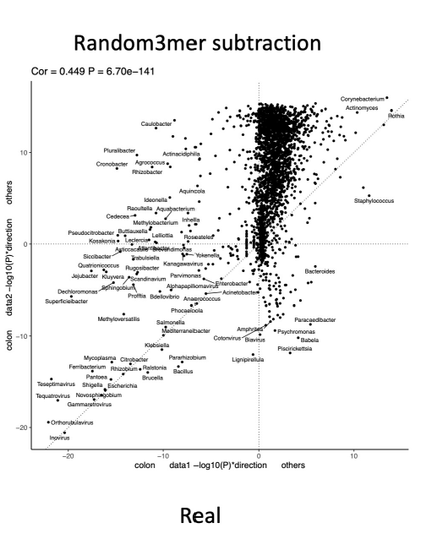
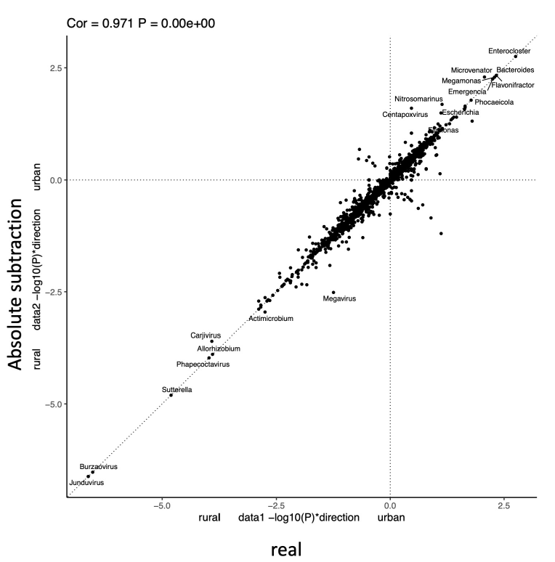
Subtracting off the expected background is showing some potential for inference

Slide 43
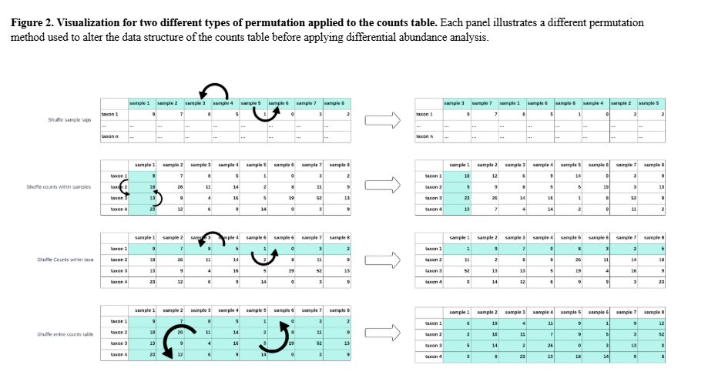
Old algorithms often have very attractive properties…

Slide 44
